Slide 1




















FRUIT ONLINE
STORE
Greeny Shop

Slide 2


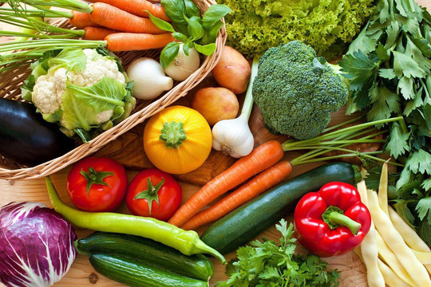
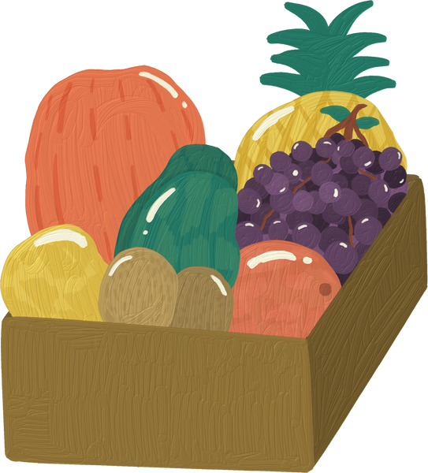

HELLO, EVERYONE!
Group leader: Lê Hồng Quang
Members: - Lê Thế Duyệt
- Hồ Dũng
- Nguyễn Hoàng Đạt

Slide 3


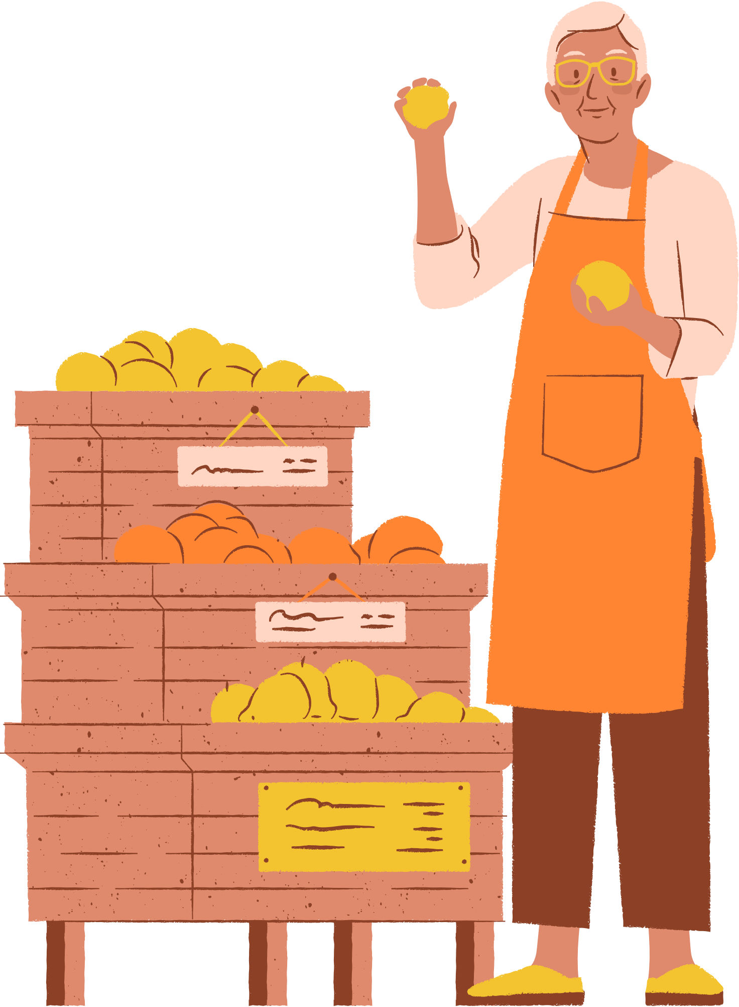



WELCOME
Fresh fruits are a crucial part of a healthy lifestyle and their consumption has gained immense popularity in recent years. The increasing demand for fresh and high-quality fruits has led to the appearance of online fruit trading platforms. Nowadays, consumers prefer buying fruits online as it offers them convenience and a wide variety of choices. However, the lack of a reliable, efficient, and affordable fruit trading service has opened the opportunity for the new fruit-selling website - Greeny

Slide 4
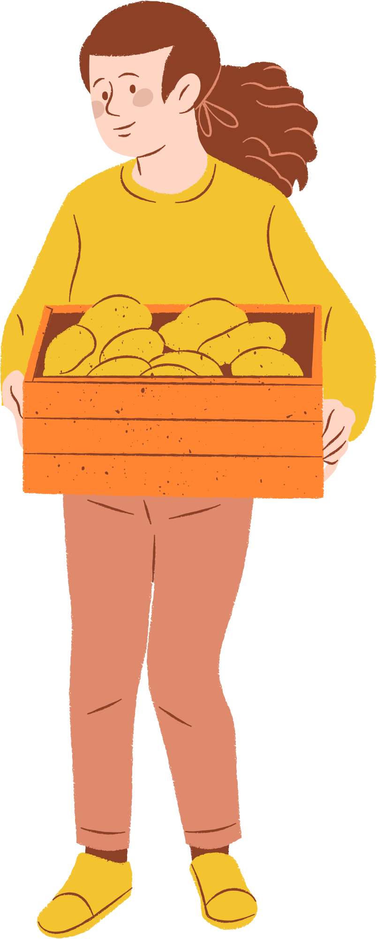

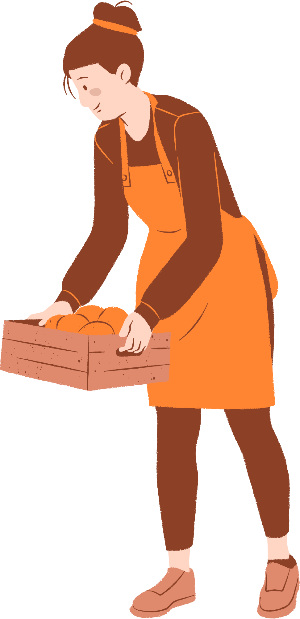
CONTENTS
1. Project scope
2. System Design
3. Theoretical Framwork
4. Future Work
5. Demo
6. Questions and answers
7. References

Slide 5


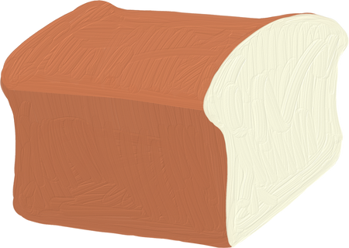


PROJECT SCOPE
A user-friendly interface with clear navigation that allows customers to easily browse and purchase products.
1
2
Detailed product information, including product descriptions, images, and nutritional information.
Multiple payment options, including credit/debit cards, digital wallets, and other digital payment methods.
3
An automated order management system that allows for efficient order fulfillment and tracking.
4
Integration with social media platforms to increase the store's online presence and reach
5

Slide 6

SYSTEM
DESIGN

Slide 7
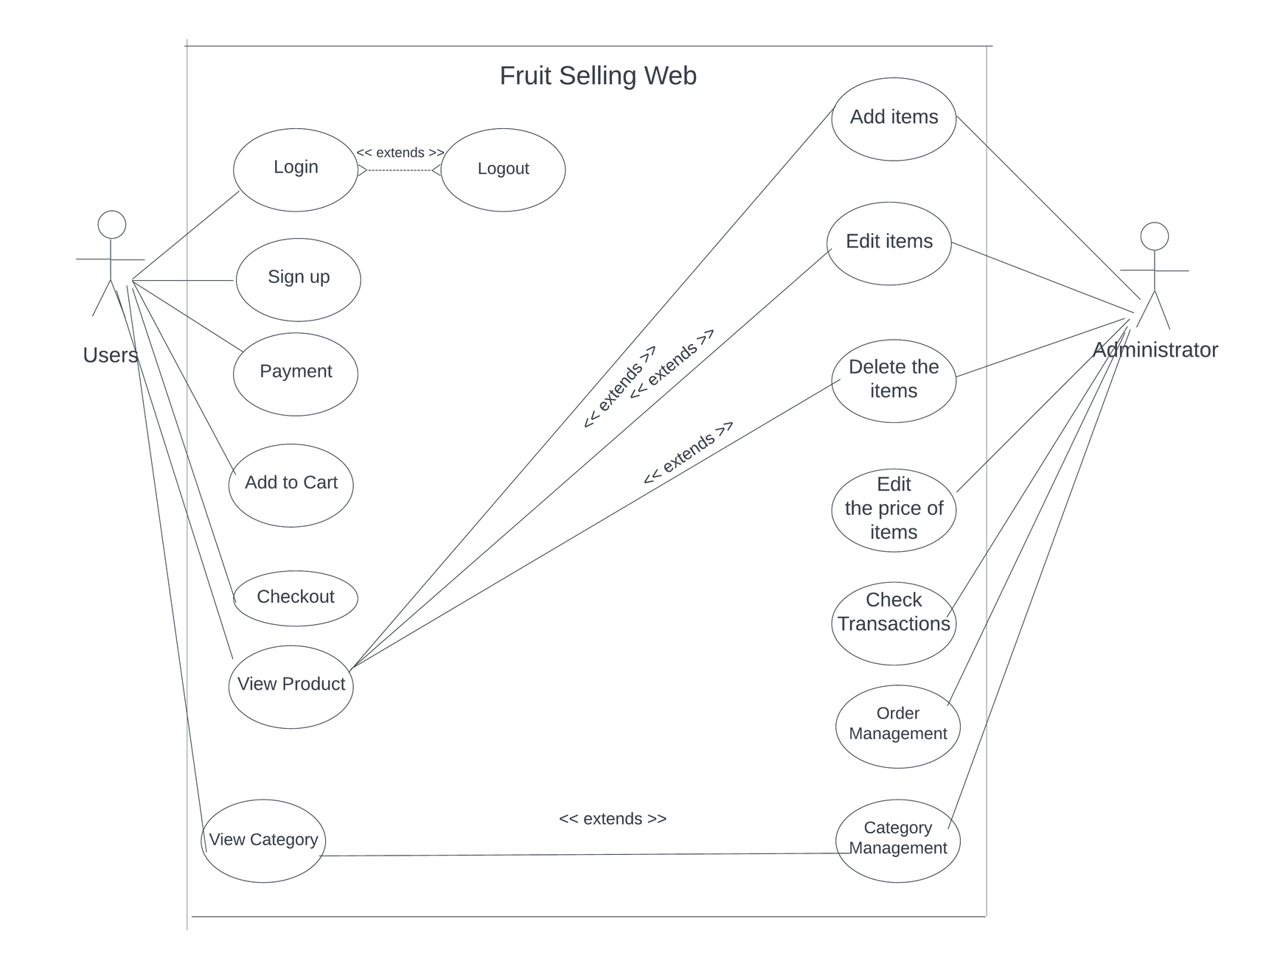
USE CASE DIAGRAM

Slide 8
USE CASE DIAGRAM
Functions of customer
Search
Product information
Add to cart
Checkout
Payment processing
Shipping and tracking
Review and feedback
Functions of Administrator
Category management
Product management
Customer management
Order management
Revenue statistics

Slide 9
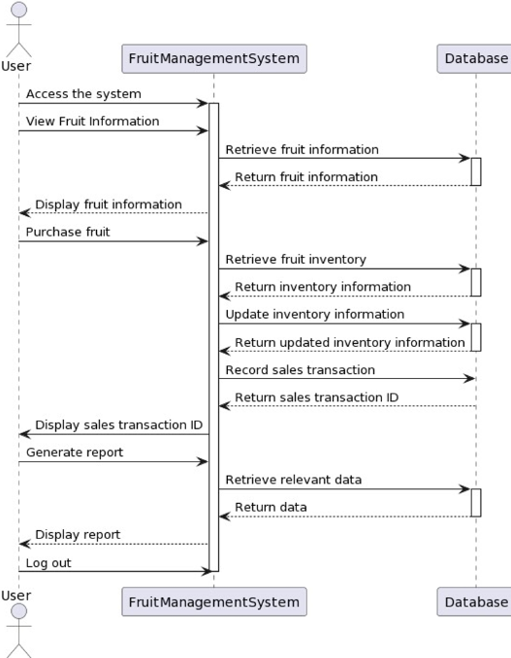
SEQUENCE
DIAGRAM
Notes:
Sequenc giơi thiệu sơ, đọc diagram

Slide 10
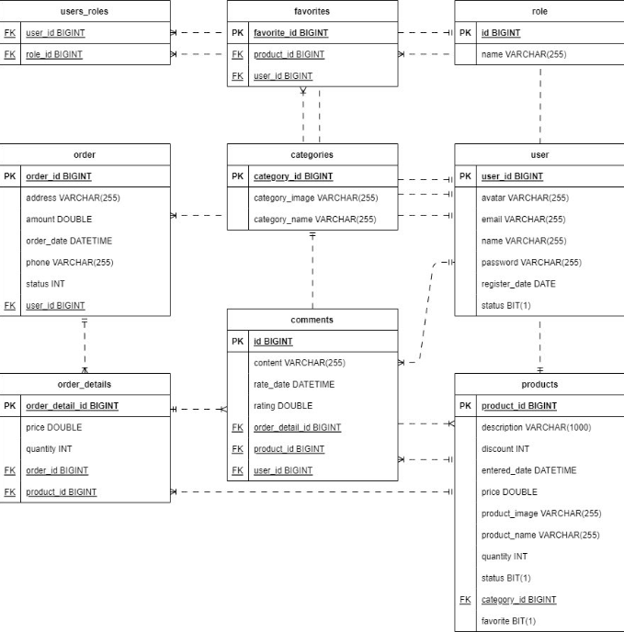
DATABASE
SCHEMA
DESIGN

Slide 11




Theoretical Framwork
1
2
3
Springboot
Framework
HTML/CSS
MySQL

Slide 12


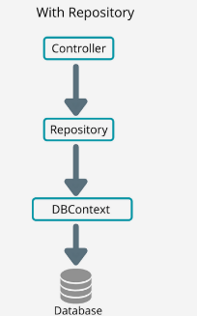
Basic Knowledge
The Repository pattern mediates between the
data source layer and the business logic layer.
The Service pattern provides a layer of
abstraction between the business logic layer and
the presentation layer.
The Unit of Work pattern is used to maintain
consistency and integrity between multiple
database operations.

Slide 13

Java (Spring)
Spring is designed to be scalable and performant, allowing applications to handle large numbers of requests without performance issues.
Spring MVC (Model-View-Controller) is a powerful framework for developing web applications, providing good support for HTTP request handling, authentication and authorization, form handling, and many other features.
Spring provides a powerful transaction management mechanism that helps process transactions securely and consistently.

Slide 14

MY SQL
- MySQL supports various programming languages and offers features like data integrity, security, scalability, and high
availability
- Widely used in enterprise applications for efficient data storage and retrieval.

Slide 15

HTML/ CSS
HTML (HyperText Markup Language) is a markup language used to create the structure and content of web pages.
CSS (Cascading Style Sheets) is a language used to format and present HTML. CSS allows you to customize colors, fonts, spacing, layout, and many other elements of the interface
HTML and CSS are supported on most browsers and devices, helping to ensure that your website can work across different platforms without compatibility issues.

Slide 16
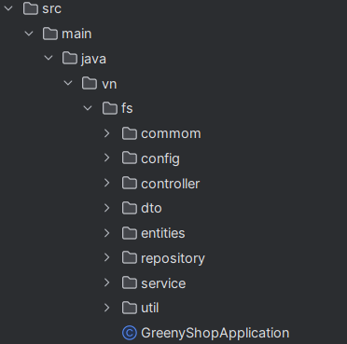
Explanation of each folder and their role:
- Controller
+Purpose: Contains controller classes that handle HTTP requests from clients.
- Entities
+ Purpose: Contains entity classes that represent tables in the database.
- Repository
+ Purpose: Contains repository classes to interact with the database.
- Service
+ Purpose: Contains service classes that implement the application's business logic.

Slide 17



FUTURE WORK

Slide 18
FUTURE WORK
Implementing a recommendation engine that suggests products based on a customer's browsing behavior or purchase history can increase sales and improve customer satisfaction.
1
As more and more customers are using smartphones to shop online, comprehensive optimization for mobile devices is essential such as implementing a responsive design and easy-to-use navigation bar.
2
Expanding the range of the products sold on the website may draw attention to many potential customers and increase revenue.
3
Encouraging customers to leave their reviews, feedback and share to social platforms by awarding them discounts for future purchases
4

Slide 19
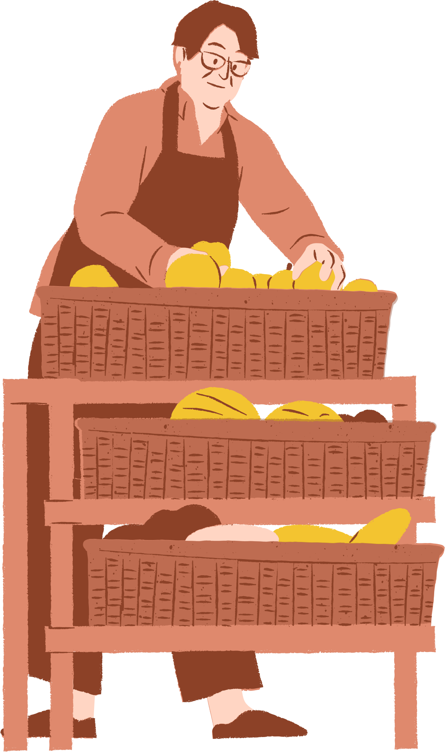

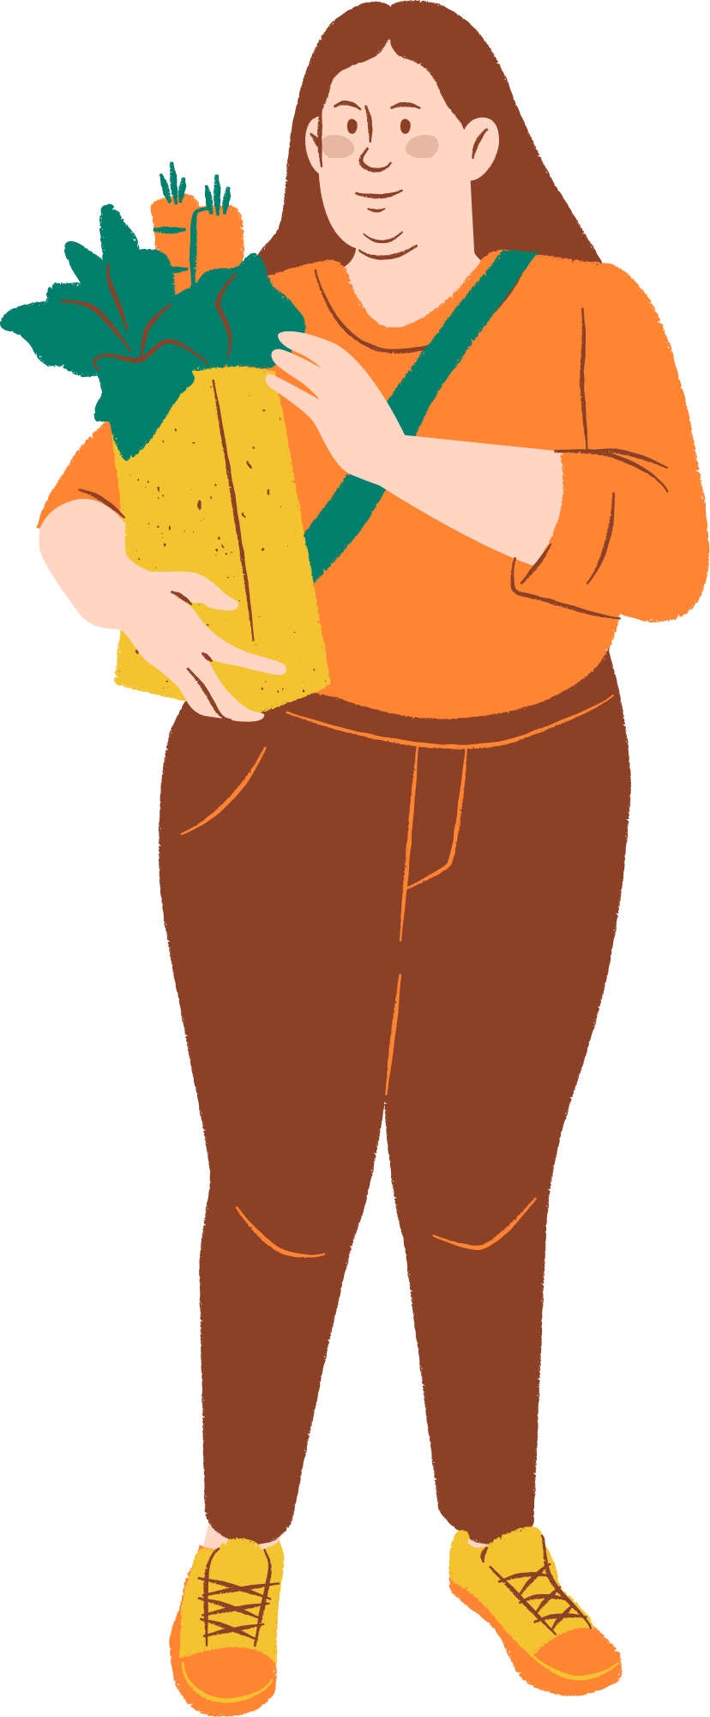

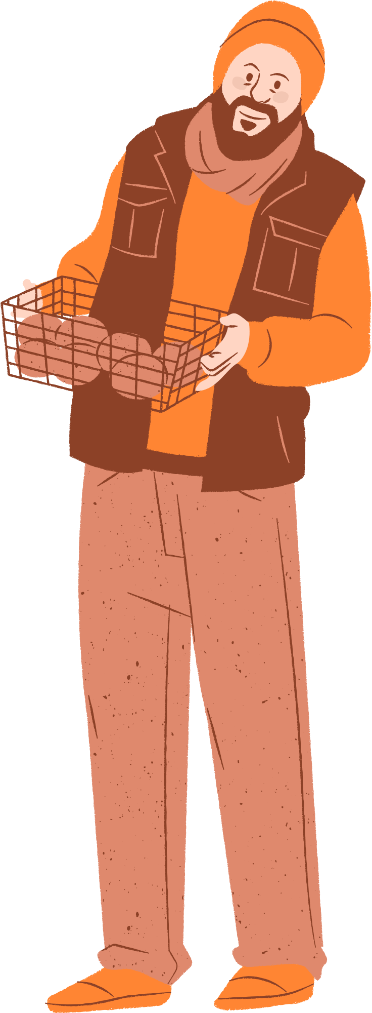
REFERENCES
MARTY HALL, LARRY BROWN “Core Servlets and JavaServer Pages™ - Volume 1 Core Technologies”, Second Edition, 2003.
MARTY HALL, LARRY BROWN “Core Web Programming”, Second Edition, 2001.
DAVE CRANE, ERIC PASCARILLO, DARREN JAMES, “Ajax in Action”, 2006.
JAMES L. WEAVER, KEVIN MUKHAR, AND JIM CRUME, “Beginning J2EE 1.4: From Novice to Professional”, 2004.
https://www.javatpoint.com/spring-tutorial
https://www.w3schools.com/js/default.asp
https://www.w3schools.com/bootstrap/bootstrap_get_started.asp

Slide 20
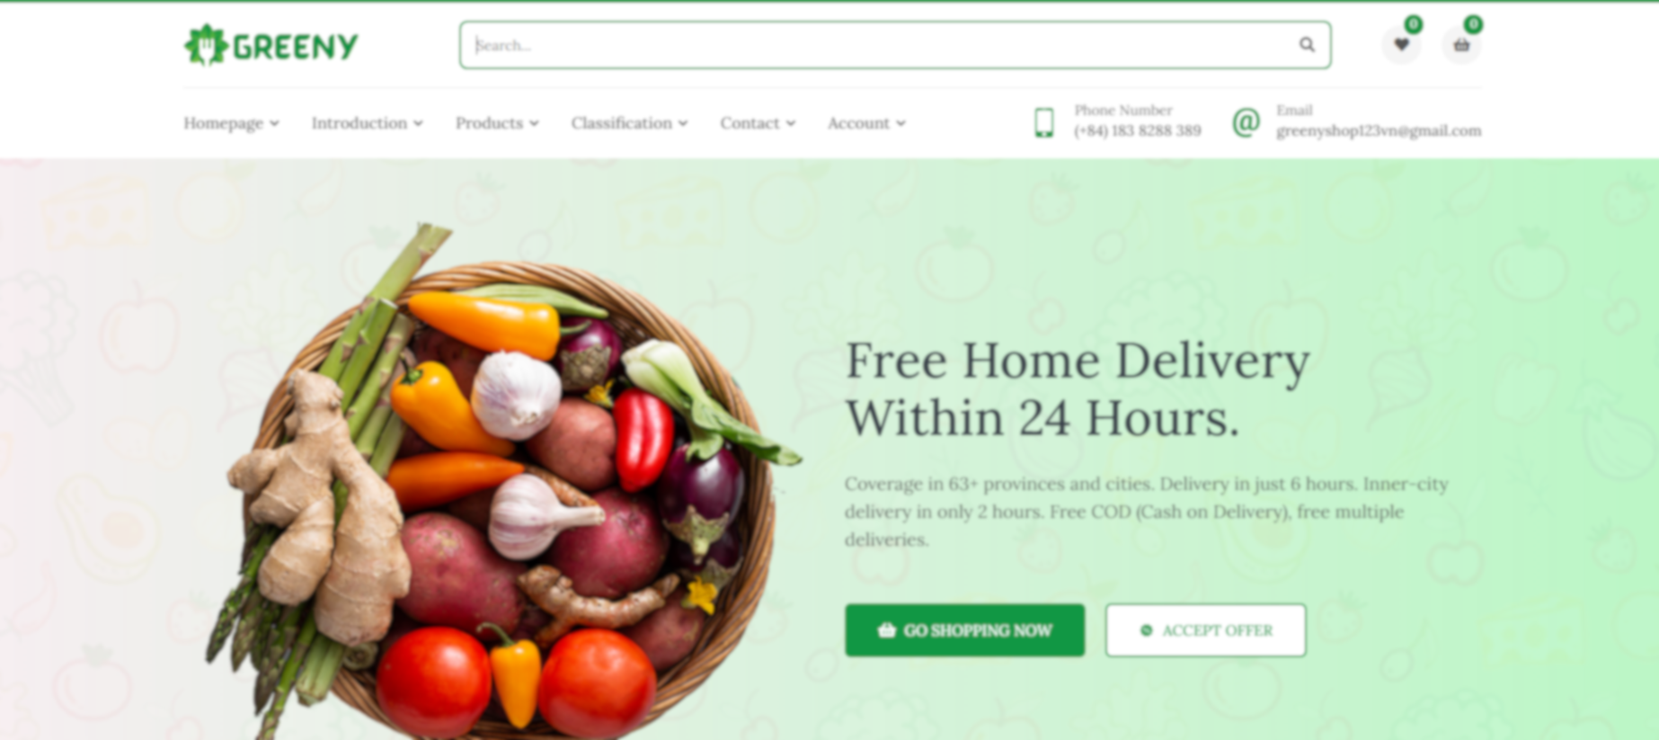
DEMO

Slide 21




ANY QUESTIONS?
Encourage the audience to ask questions, provide feedback, share their insights, etc.

Slide 22
THANK YOU FOR WATCHING!
Feel free to reach out to us through any of the following:
WEBSITE:
EMAIL:
greenyshop.com
webproject@gmail.com
Facebook:
Greeny-shop fruit

